Slide 1

Connecting to the Nest thermostat via OpenDOF

Slide 2
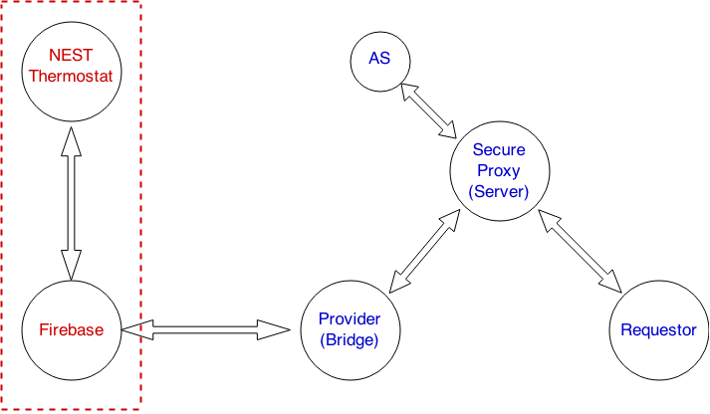
Communication Protocol

Slide 3
Firebase
The provider can get information from the Nest device through the Firebase API
Firebase myFirebase = new Firebase(“https://developer-api.nest.com”);
Use this object to get more specific information about this particular thermostat:
fbAmbientTemperature = myFirebase.child(“/devices/thermostats/” + thermostat_id + “/ambient_temperature_f”);
Uses the “parent” Firebase object
The Nest device is specified by a unique thermostat_id
Use this object to set properties:
fbTargetTemperature.setValue()

Slide 4
Firebase (continued)
Adding a Value Event Listener to a Firebase object allows receiving real-time information in a DataSnapshot
new ValueEventListener overrides two methods: onCancelled() and onDataChange()
Snapshot:
{thermostats={7jSKjTRE95KDWUGLOhWvc51kkI1TJ4UE={is_online=true, last_connection=2015-03-03T15:09:34.846Z, locale=en-US, target_temperature_low_f=86, target_temperature_high_c=31.5, target_temperature_f=79, software_version=4.3.3, target_temperature_c=25.5, name=Basement, away_temperature_high_f=80, ambient_temperature_f=73, ambient_temperature_c=22.5, away_temperature_low_c=10.0, name_long=Basement Thermostat, can_cool=true, away_temperature_low_f=50, away_temperature_high_c=26.5, has_leaf=true, target_temperature_low_c=30.0, temperature_scale=F, can_heat=true, structure_id=nZyclzv_SGNGRDPYT1x706BkhKwikt2JyDHhnL1l-uItVQXhgANsFQ, device_id=7jSKjTRE95KDWUGLOhWvc51kkI1TJ4UE, hvac_mode=off, is_using_emergency_heat=false, target_temperature_high_f=89, has_fan=true, fan_timer_active=false, humidity=25}}}

Slide 5
More options
Firebase has libraries available in JavaScript, Objective C and Java
iOS, Android, and Web Apps can be built
Other communication methods are available
JSON or Gson formats
Using HttpGet requests and HttpResponse messages
REST
Possible to get / set values directly from the terminal

